Slide 1
Dr. Karnaugh’s Lab
Game Code

Slide 2
Features
Basic game functionality:
User can interact with components in the maze and solve the puzzles, moving on to the next map and earning points
The user has a time limit, after which a killer bunny will bite their face off
Ranked Game
Extension of the base game to manage maps and score differently, and submit score to online database

Slide 3
High Score Table
PHP + MySQL for storing data
Hash function to fight cheating
Easily extensible to store persistent user accounts, statistics, achievements, etc.

Slide 4
Gameplay
Click Interactions
guiOverlayItems
Cursors
Utilizing the status bar swing components

Slide 5
The Bunny
It’s a pink sphere, so you’ll have to use your imagination.
Bunny knows how to do two things:
Chase
Kill

Slide 6
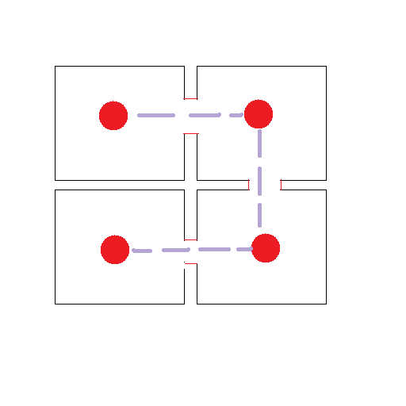
Chase Mode, Sample Node Graph

Slide 7
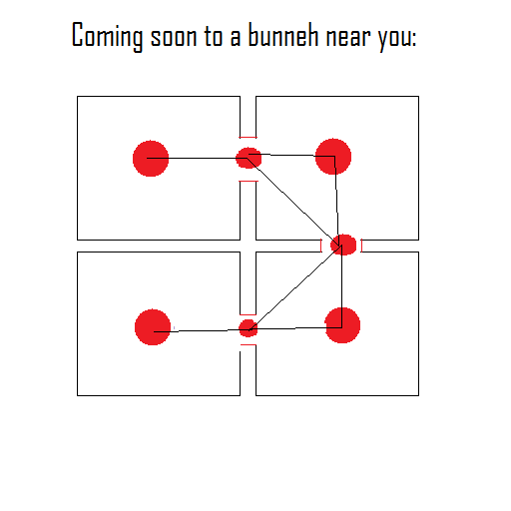
Better Sample Node Graph

Slide 8
Future Developments
User accounts / Better RankedGame
Building a better bunny
Improving the graphics
GUI map creation tools
Wire dragging/ Goggles gameplay mechanic
User customization
More story/characters
More

